Slide 1

Business Data Management Final Project
BIN LIU
TIANBO LIU
VAIBHAV VESMAKER

Slide 2
Superstore Dataset
E
&
ER Diagram

Slide 3


Original Dataset
Original Dataset
The Superstore dataset includes the data of products, regions, categories, customer segments, profits and sales.

Slide 4
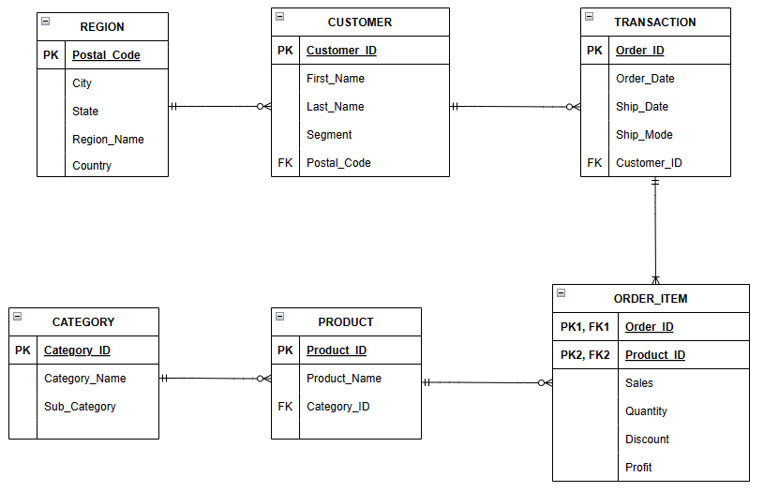
ER Diagram

Slide 5
Import Datasets to Database
Data
Cleaning
&

Slide 6
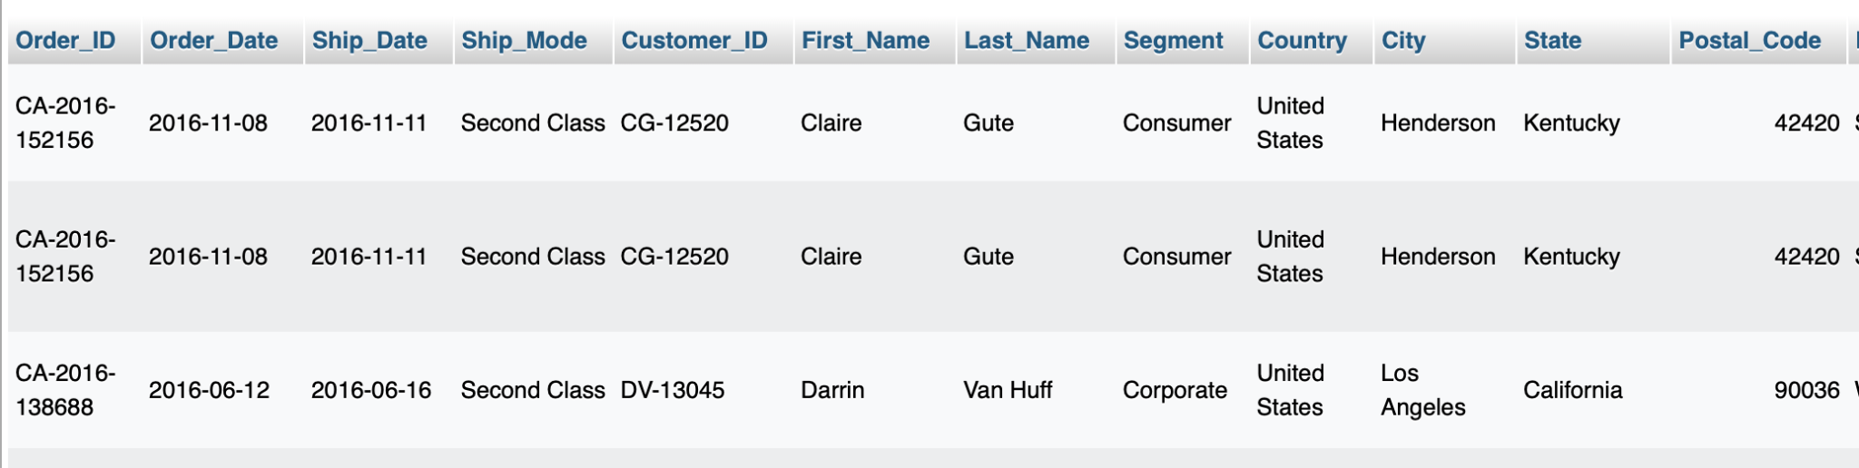
Import Dataset to MySQL Using SQL Code
CREATE DATABASE IF NOT EXISTS Final_project;
USE Final_project;
CREATE TABLE Superstore (
Order_ID VARCHAR (50),
Order_Date DATE,
Ship_Date DATE,
Ship_Mode VARCHAR(50),
Customer_ID VARCHAR (50),
First_Name VARCHAR (50),
Last_Name VARCHAR (50),
Segment VARCHAR (50),
Country VARCHAR (50),
City VARCHAR (50),
State VARCHAR (50),
Postal_Code INT,
Region_Name VARCHAR (20),
Product_ID VARCHAR (100),
Category_Name VARCHAR (100),
Sub_Category VARCHAR (100),
Product_Name VARCHAR (255),
Sales FLOAT (15),
Quantity INT,
Discount FLOAT (10),
Profit FLOAT (15)
);

Slide 7
1) Find all customers with no last name in the dataset
SELECT Customer_ID, First_Name FROM Superstore
WHERE Last_Name = '';
2) Delete the data for ‘Sample A Company’
DELETE FROM Superstore
WHERE First_Name like 'Sample%';
3) Update the format of customer name ‘Corey-Lock’ into first name and last name columns
UPDATE Superstore
SET First_Name = SUBSTRING_INDEX('Corey-Lock', '-', 1),
Last_Name = SUBSTRING_INDEX('Corey-Lock', '-', -1)
WHERE First_Name='Corey-Lock’;
4) Adding leading 0 to postal codes that are missing
ALTER TABLE Superstore
MODIFY Postal_Code CHAR(5);
UPDATE Superstore
SET Postal_Code = LPAD(Postal_Code, 5, '0’)
WHERE LENGTH(Postal_Code) <5;
Data Cleaning with SQL Code

Slide 8
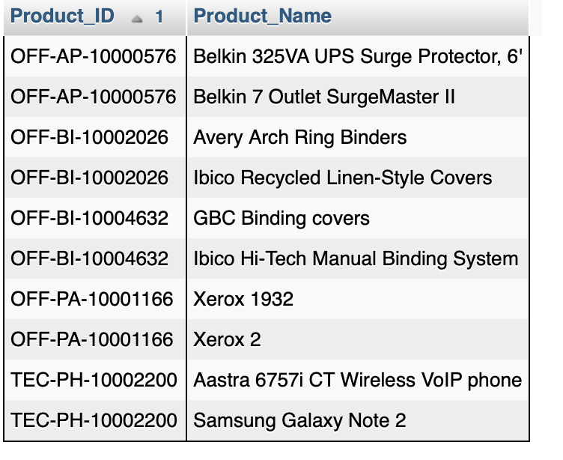
5) Identify the product IDs that are associated with more than one product name and update to assign unique product ID for each product
SELECT Product_ID, Product_Name FROM Superstore
WHERE Product_ID IN(
SELECT Product_ID
FROM Superstore
GROUP BY Product_ID
HAVING COUNT(DISTINCT Product_Name) > 1
)
GROUP BY Product_ID, Product_Name
ORDER BY Product_ID;
UPDATE Superstore
SET Product_ID = CASE
WHEN Product_Name = 'Belkin 325VA UPS Surge Protector, 6''' THEN 'OFF-AP-10000576'
WHEN Product_Name = 'Belkin 7 Outlet SurgeMaster II' THEN 'OFF-AP-10000776'
WHEN Product_Name = 'Avery Arch Ring Binders' THEN 'OFF-BI-10002026'
WHEN Product_Name = 'Ibico Recycled Linen-Style Covers' THEN 'OFF-BI-10003026'
WHEN Product_Name = 'GBC Binding covers' THEN 'OFF-BI-10004632'
WHEN Product_Name = 'Ibico Hi-Tech Manual Binding System' THEN 'OFF-BI-10004633'
WHEN Product_Name = 'Xerox 1932' THEN 'OFF-PA-10001166'
WHEN Product_Name = 'Xerox 2' THEN 'OFF-PA-10001176'
WHEN Product_Name = 'Aastra 6757i CT Wireless VoIP phone' THEN 'TEC-PH-10002200'
WHEN Product_Name = 'Samsung Galaxy Note 2' THEN 'TEC-PH-10002220'
END
WHERE Product_ID IN('OFF-AP-10000576', 'OFF-BI-10002026','OFF-BI-10004632','OFF-PA-10001166','TEC-PH-10002200');

Slide 9
6) Create a new column for category ID that identify each sub-category
CREATE TABLE category_mapping (
Category_ID INT AUTO_INCREMENT PRIMARY KEY,
Sub_Category VARCHAR (100) UNIQUE
);
INSERT INTO category_mapping (Sub_Category)
SELECT DISTINCT Sub_Category
FROM Superstore;
ALTER TABLE Superstore
ADD COLUMN Category_ID INT;
UPDATE Superstore
JOIN category_mapping map ON Superstore.Sub_Category = map.Sub_Category
SET Superstore. Category_ID = map.Category_ID;

Slide 10
Normalized Tables
Index
&

Slide 11
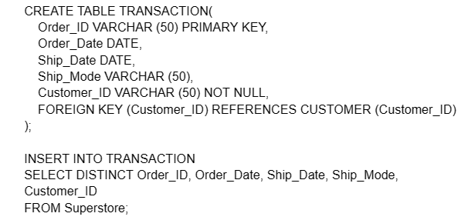
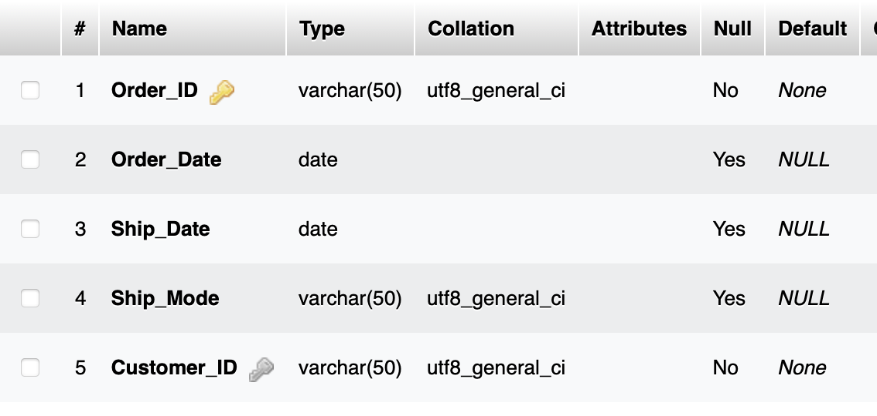
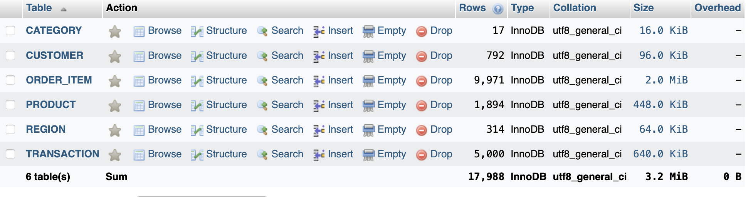
Normalized Tables

Slide 12
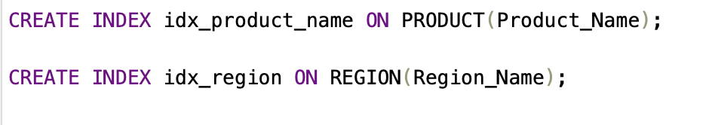
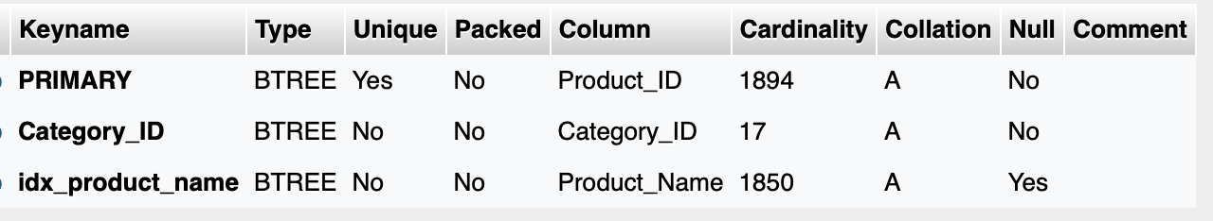
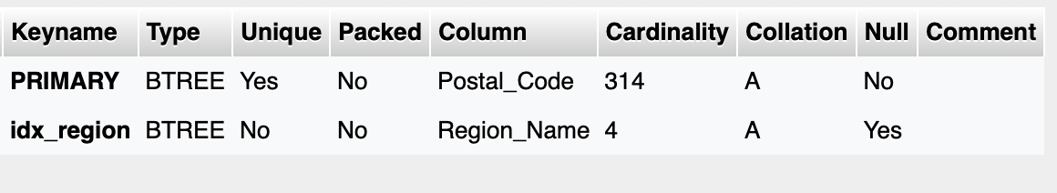
INDEX

Slide 13
SQL Questions

Slide 14

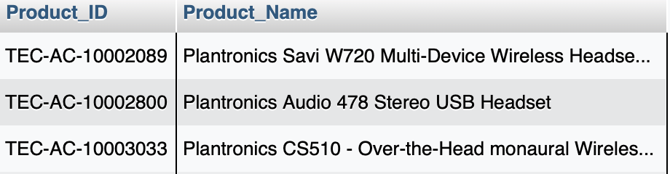

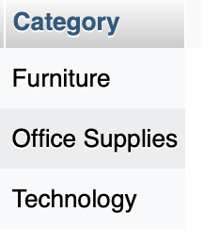

Slide 15
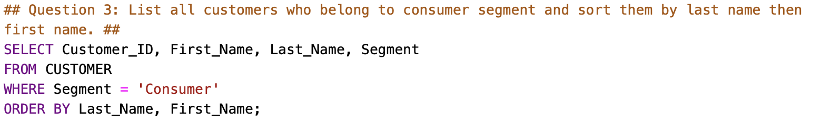
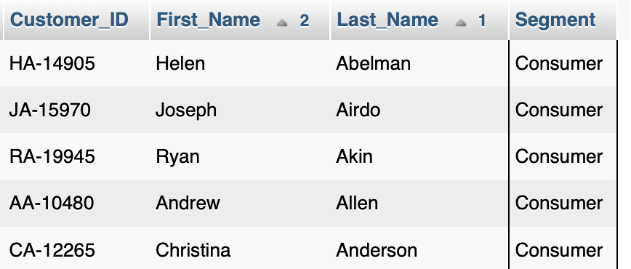

Slide 16
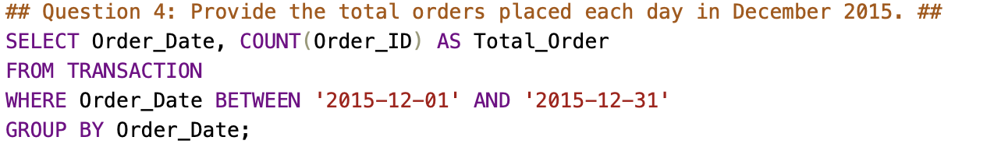
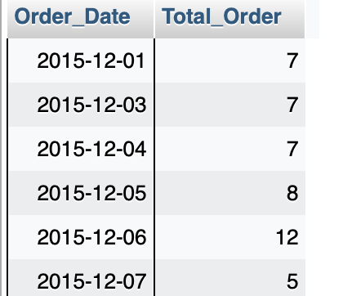

Slide 17
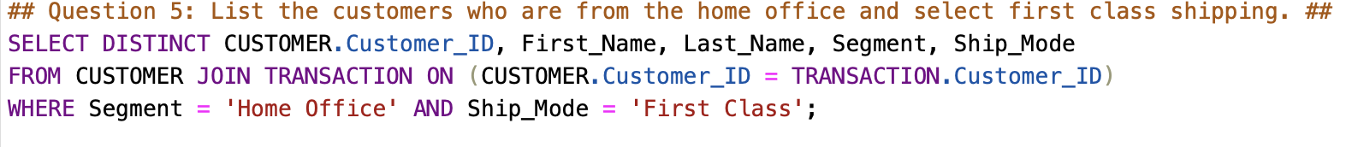
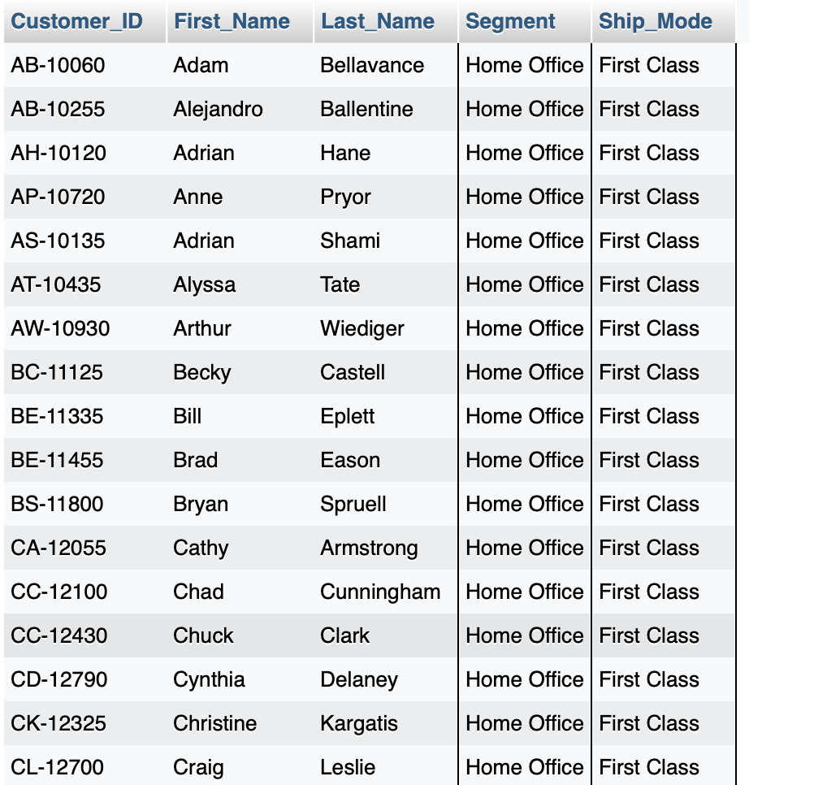

Slide 18
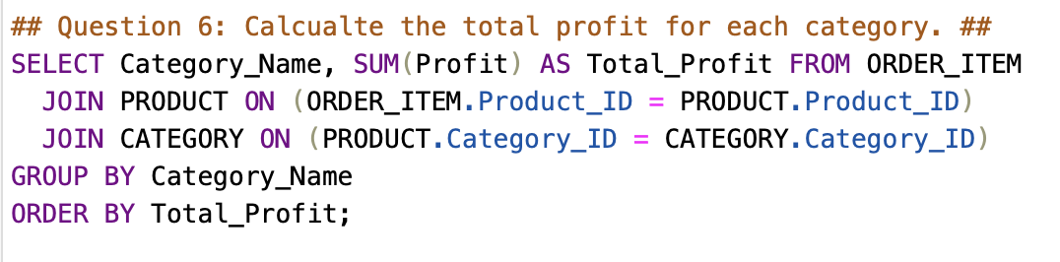
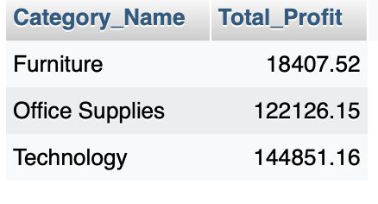

Slide 19
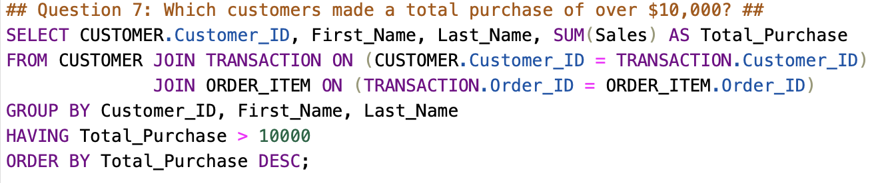
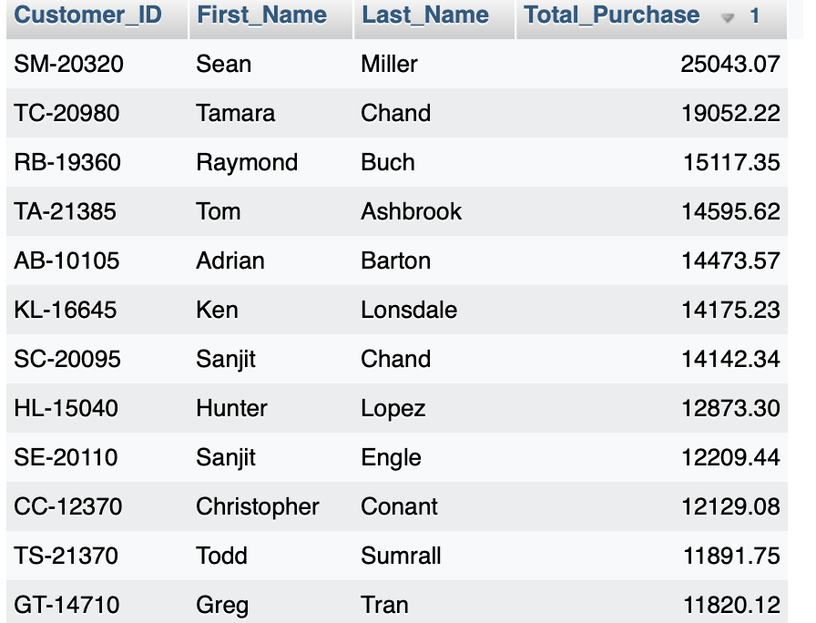

Slide 20
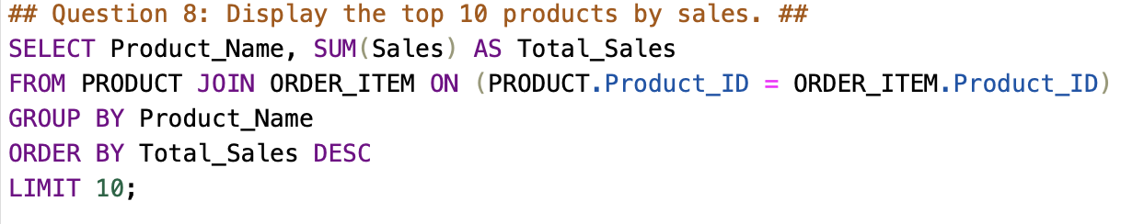
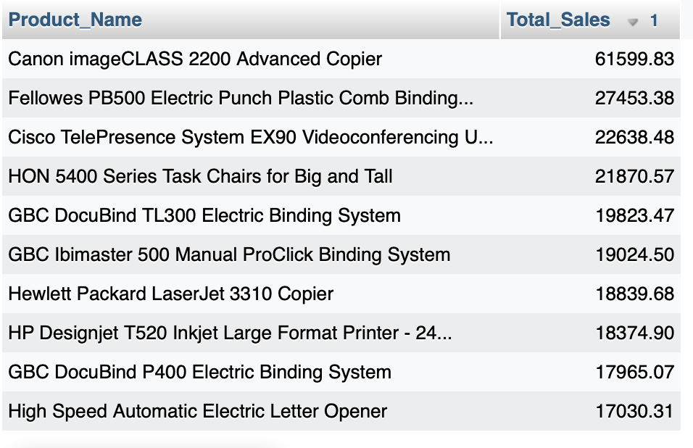

Slide 21
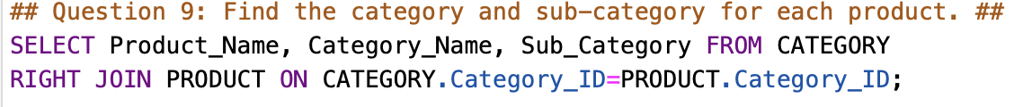
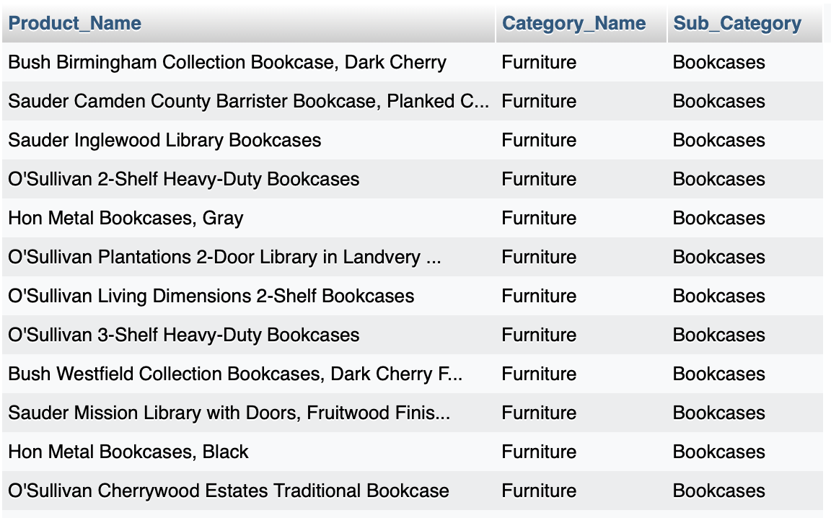

Slide 22
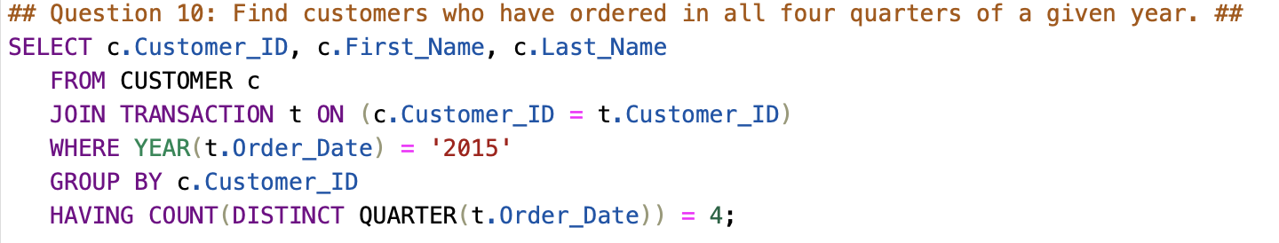
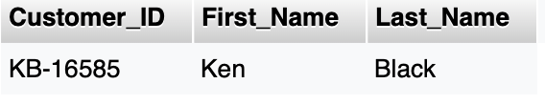
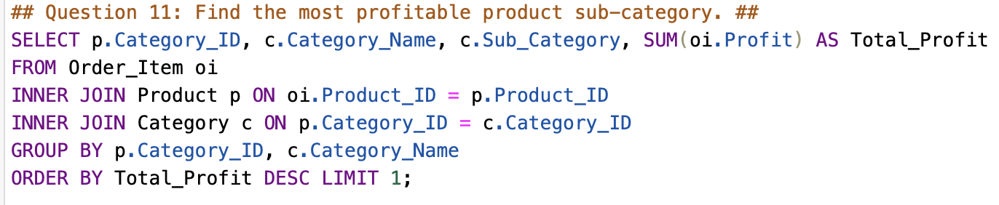
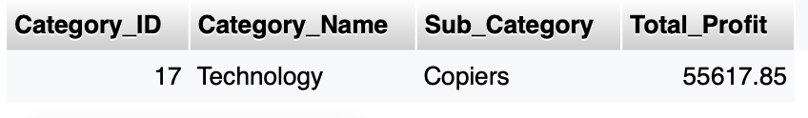

Slide 23
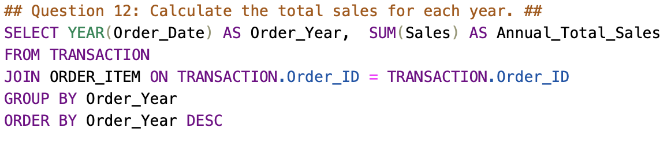
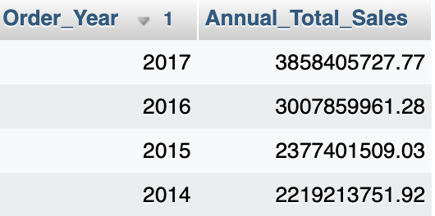
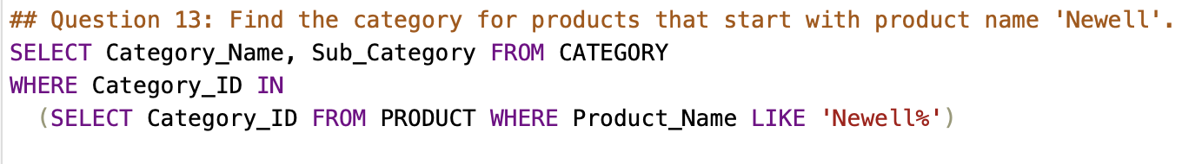
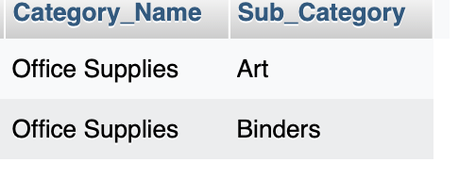

Slide 24
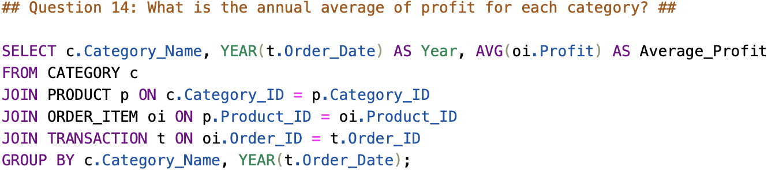
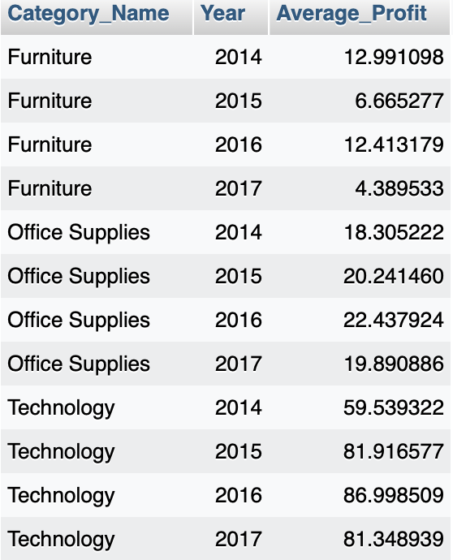

Slide 25
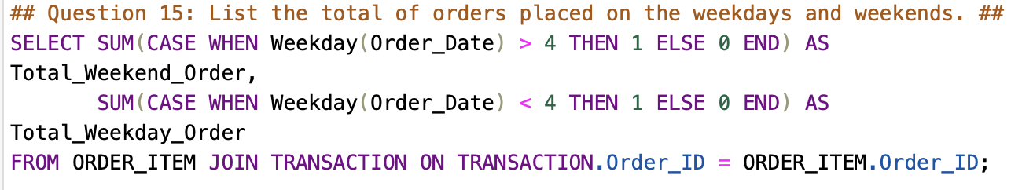
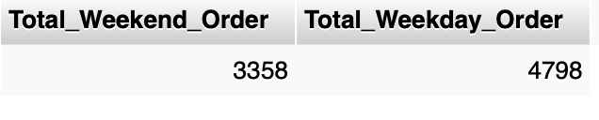

Slide 26
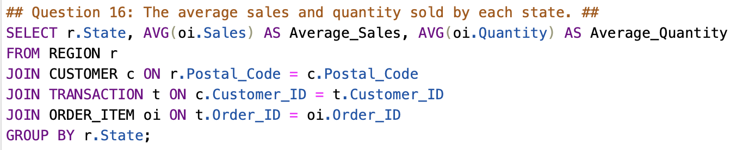
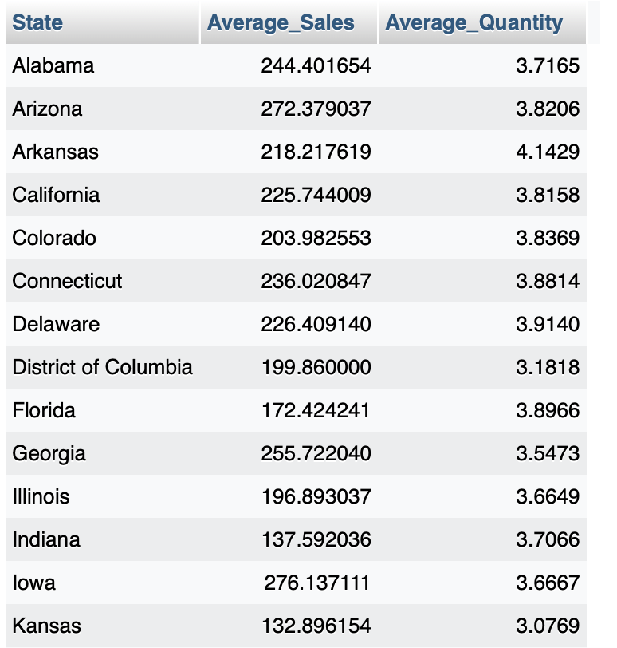

Slide 27
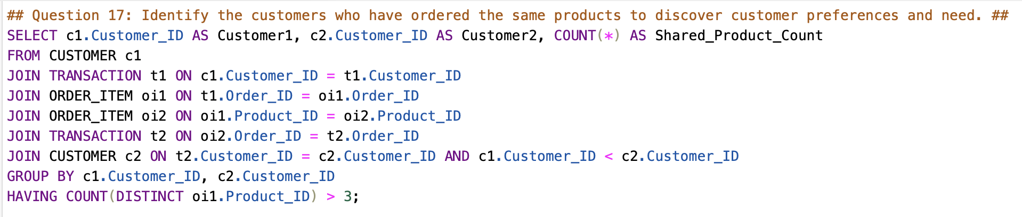
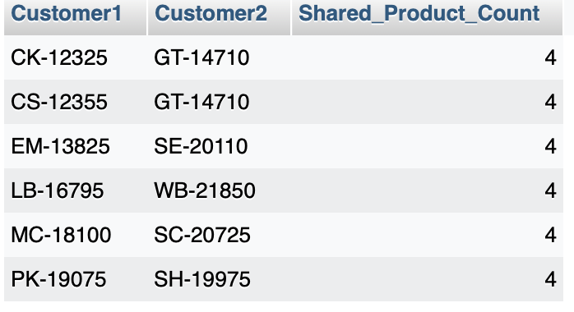

Slide 28
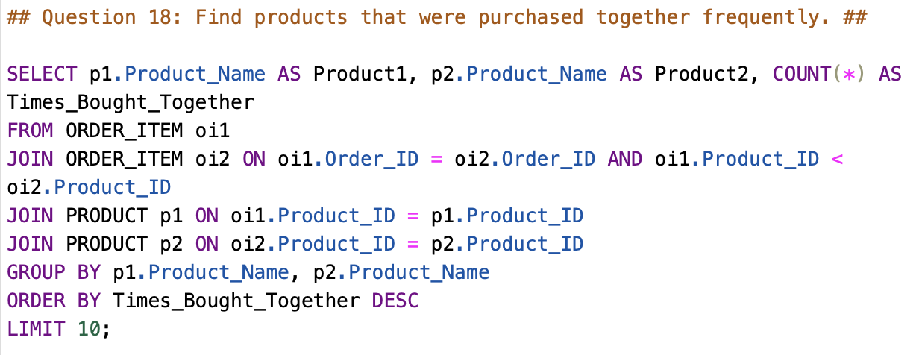
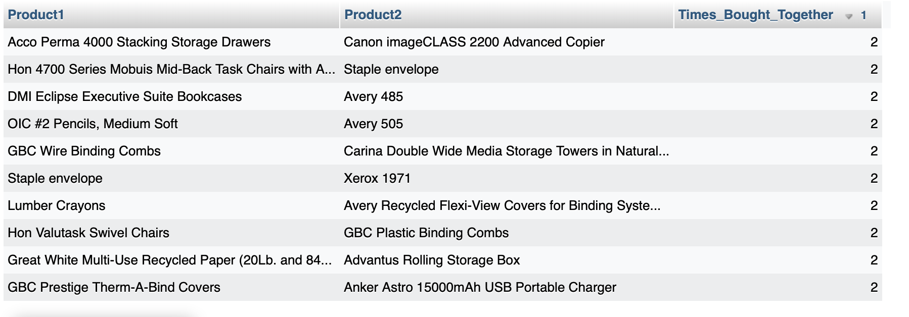

Slide 29
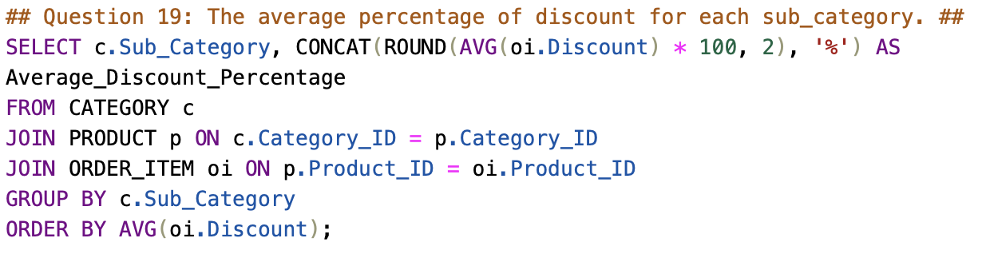
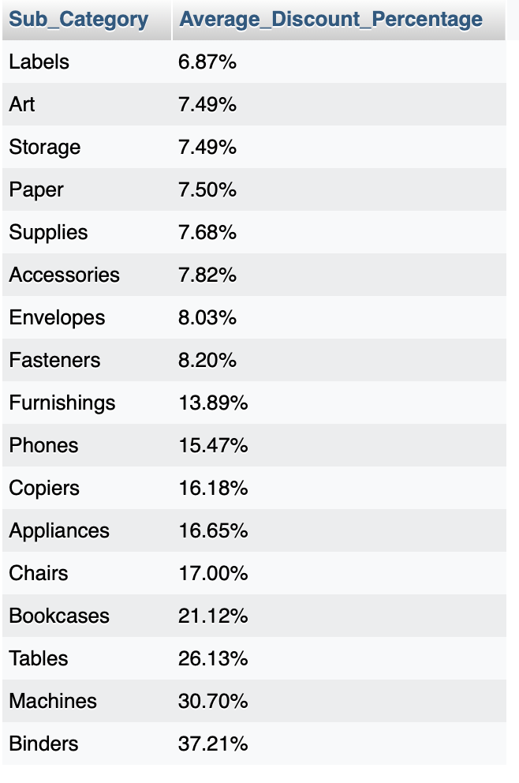

Slide 30
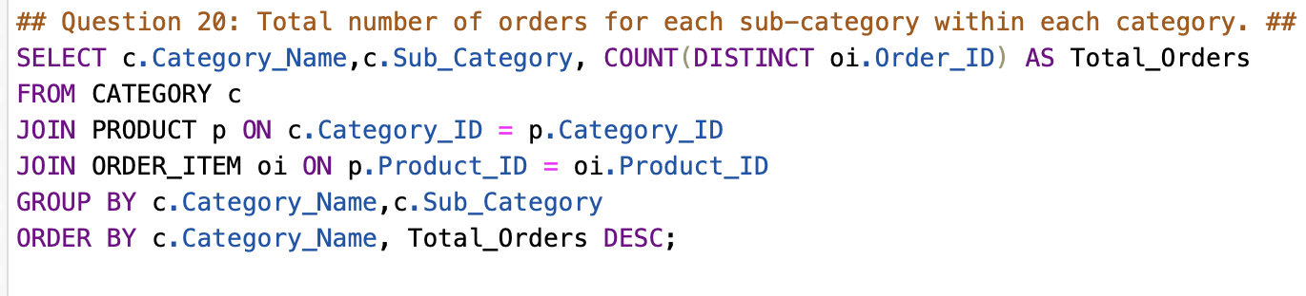
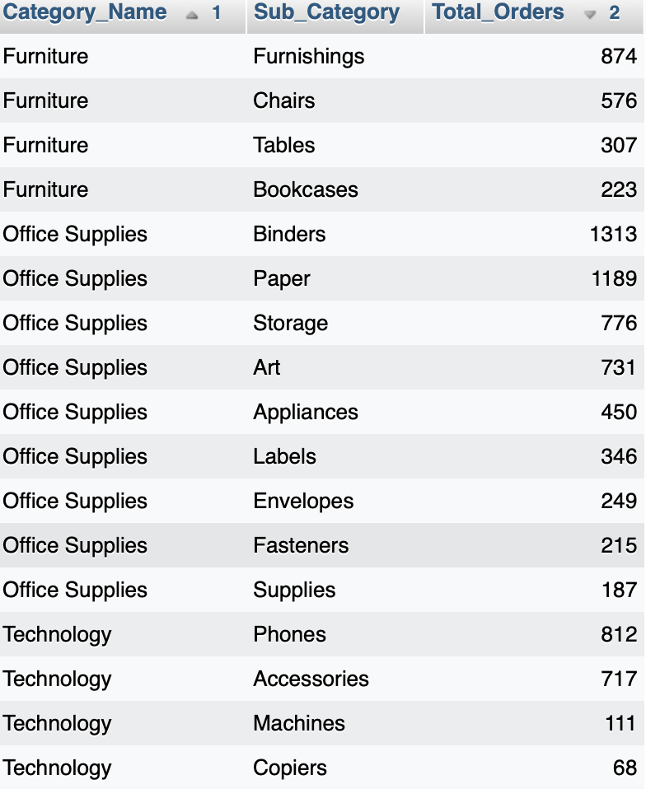

Slide 31
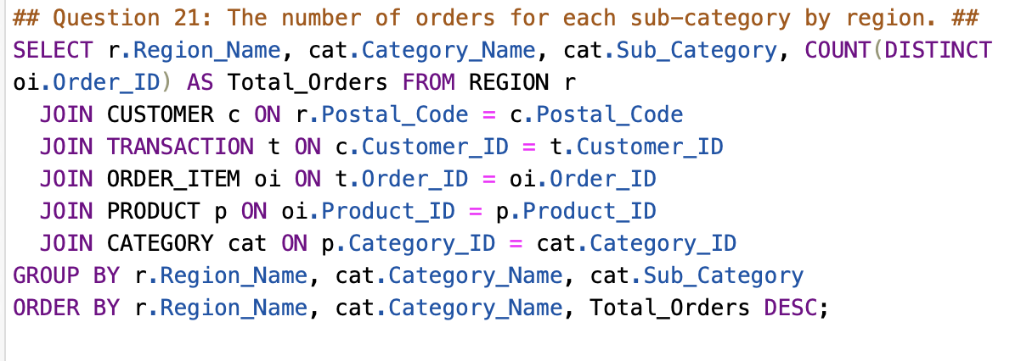
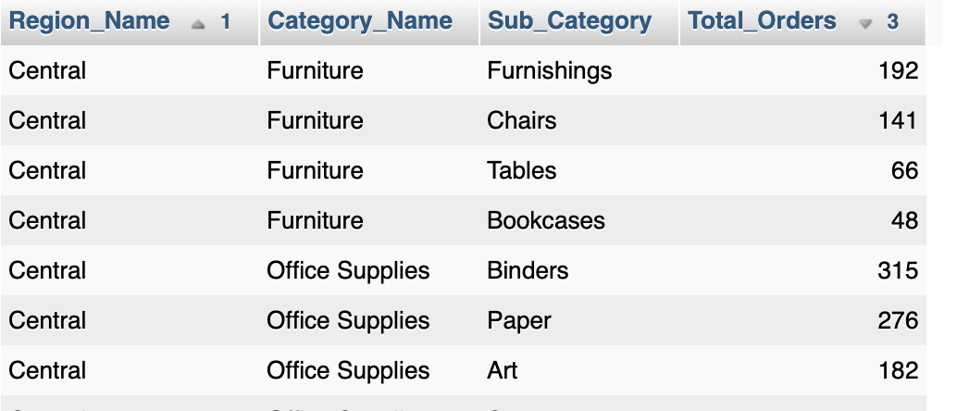

Slide 32
Visualizations

Slide 33
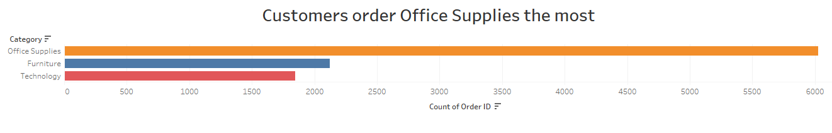



Slide 34



Slide 35


Slide 36


Slide 37
Q&A

